Slide 1
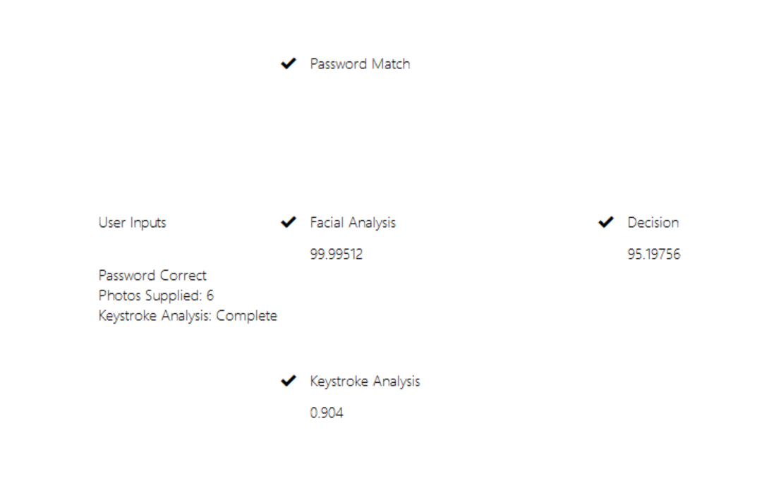









Multi-Modal Authentication using Facial Recognition and Keystroke Analysis
1. Why is it needed?
With cyber security now on the forefront of business plans, multi-factor authentication is known by most employees. However, many employees often complain that it is too intrusive. This programme offers an alternative to your standard authentication practices.
2. What is it?
The application allows for seamless authentication for the end user while allowing the wider company control over what access a user may be granted with their current authentication level.
3. Core Features:
Facial Recognition: Checks if the user’s face looks like their enrolment image.
Keystroke Analysis: Uses machine learning to predict whether the current user’s typing patterns are consistent with previous successful authentications.
Enrolment integrated into programme.
Future Implementation includes Face Liveness.
Technologies:
Alexander Williams BSc (Hons) Cyber Security alexwilliams7871@gmail.com

